Slide 1



Minor Project Report - I
Project Review
Team Mentor :
Mrs.M.Saratha AP/AI

Slide 2
Team Members
01
02
03
Deepika Merlin N - 927622BAL006
Team Leader
Jayanthan S - 927622BAL016
Varshini S - 927622BAL053

Slide 3
Table of Content
01
02
03
Introduction
Abstract
Features
04
Future Implementation

Slide 4



01
Introduction
An Overview of Our Project

Slide 5
Introduction
For our proposal, we have already conducted a study. The majority of respondents said they would like to see our idea implemented in daily life.
In their uncharted territories, it assists them to obtain a
freight shipping vehicle.
More money may be made by shipping goods by putting this concept into practice in both urban and rural areas.

Slide 6




100+
We collected these much response through this Survey

Slide 7
85% of people welcomed our project

Slide 8
02
Abstract
An Overview of our Project

Slide 9
Abstract
Cargo tracking: Using GPS technology or other tracking methods, agents can monitor the location of cargo in real time and provide updates to shippers and consignees. This information can be used to identify and resolve any delays or disruptions to shipments
Vehicle allotment: Agents match the right vehicle to the right shipment, taking into account factors such as the size and weight of the cargo, the distance to be traveled, and the required delivery deadline
Freight management: Agents can provide a range of freight management services, such as customs clearance, warehousing, and last-mile delivery.

Slide 10
Risk Management
Reduce shipping costs: By optimizing vehicle utilization and selecting the most efficient routes, agents can help businesses to save money on shipping costs.
Improve customer service: By providing real-time tracking information and ensuring that shipments are delivered on time, agents can help businesses to improve their customer service reputation
Reduce risk: By monitoring shipments and identifying potential problems early on, agents can help businesses to reduce the risk of delays, damage, and loss.

Slide 11

Features
03
Facilities given by ourself

Slide 12
Our Service
All kind of frights transportation
Bulg Transportation
Railways
Waterways
100+
25+
75+
90+
Roadways
Airways
All Kind of facility available
Light weight goods alone

Slide 13
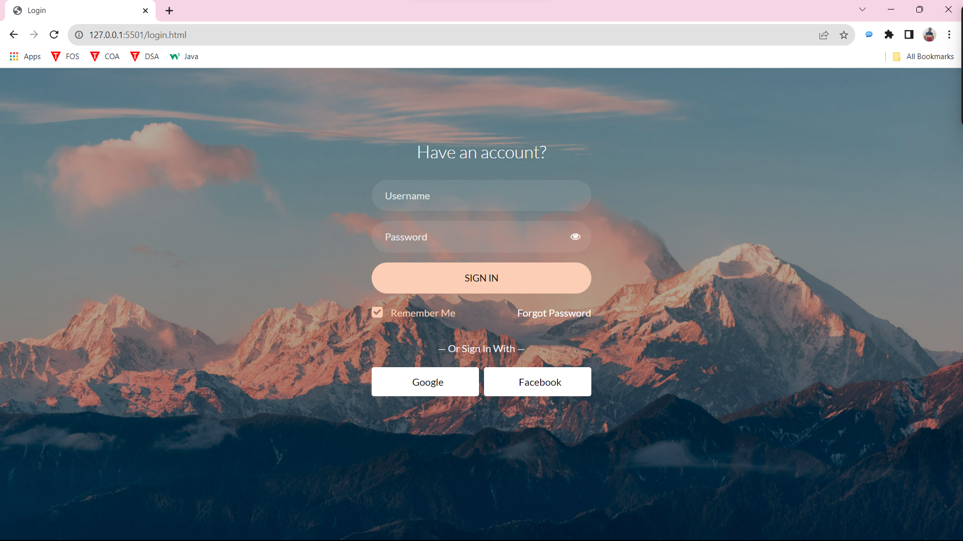
Login Page

Slide 14
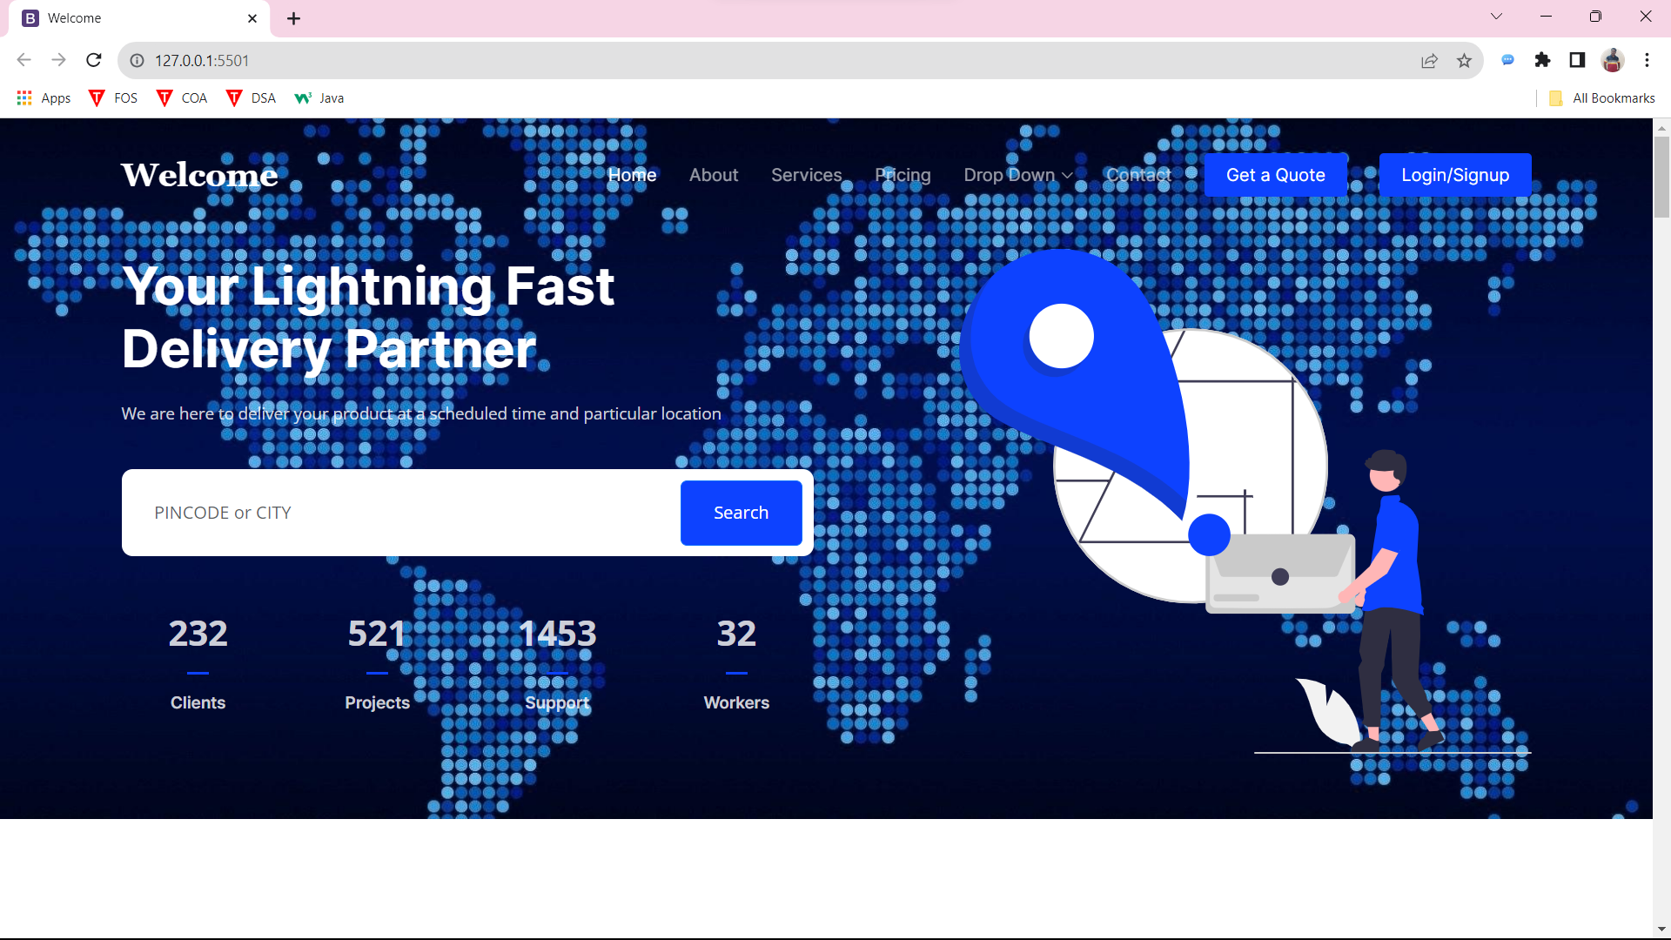
Official Page

Slide 15
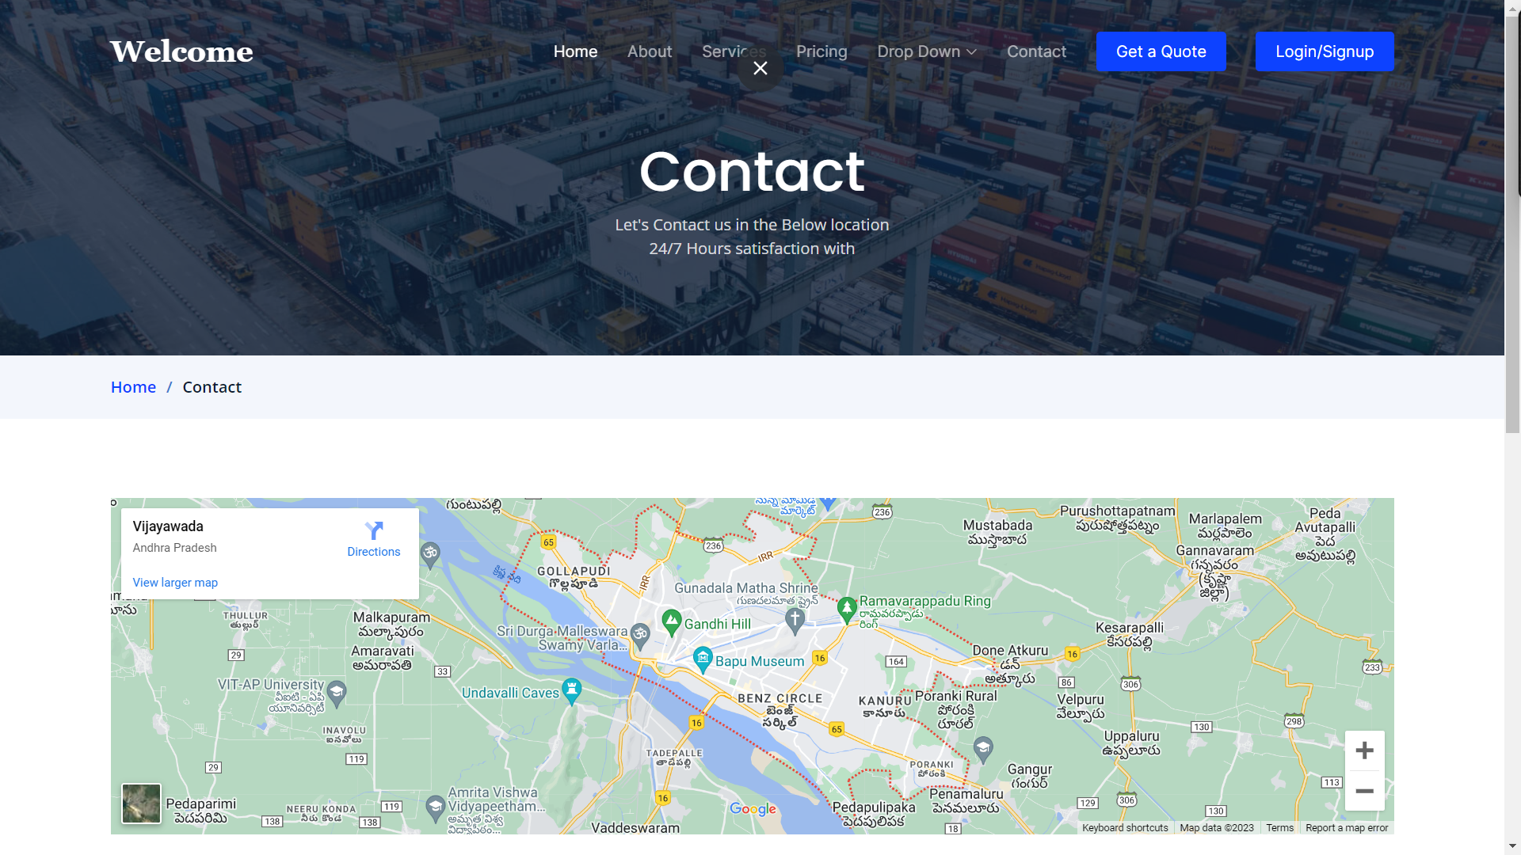
Contact Page

Slide 16


With the help of this, we can analyze the automobile using the opencv idea to scan the cargo or bale and arrange the right vehicle for them. We can also quickly identify our goods using Google API and Arduino GPS tracking, which also displays the precise pickup and delivery times.

Slide 17
04
Future Implementation
The plan of future

Slide 18
We are putting this concept into practice locally, such as in our neighboring cities, and we want to do so in the future using higherlevel mechanisms from other states and nations as well.

Slide 19

Conclusion
Our goal is to serve people with all of our hearts; fulfilling customer requests is more important to us than making money.

Slide 20
Thank You.

